Slide 1
CS 319 Term Project – Group 1J
ReviewTool
Mustafa Anıl Taşdan
Göktuğ Çağıran
Cihan Can Kılıç

Slide 2
Use Case Diagram

Slide 3
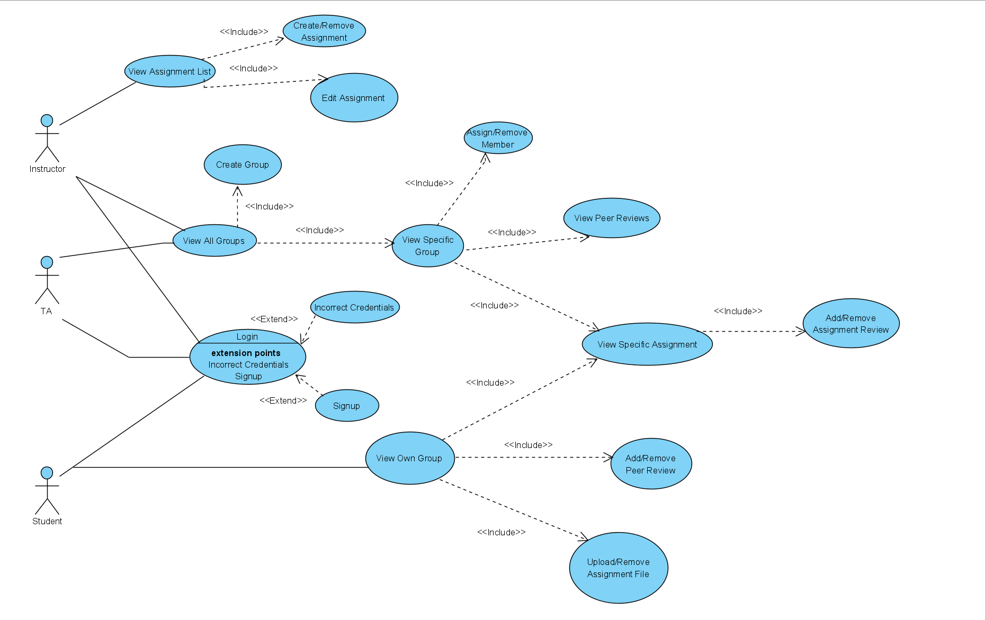

Slide 4
Non-functional Requirements
Low Cost / Simplicity: We are a small team.
Usability / Reliability: The program must have minimal support requirements because of the point above.
Security: The program will store personal educational data.

Slide 5
Class Diagram

Slide 6
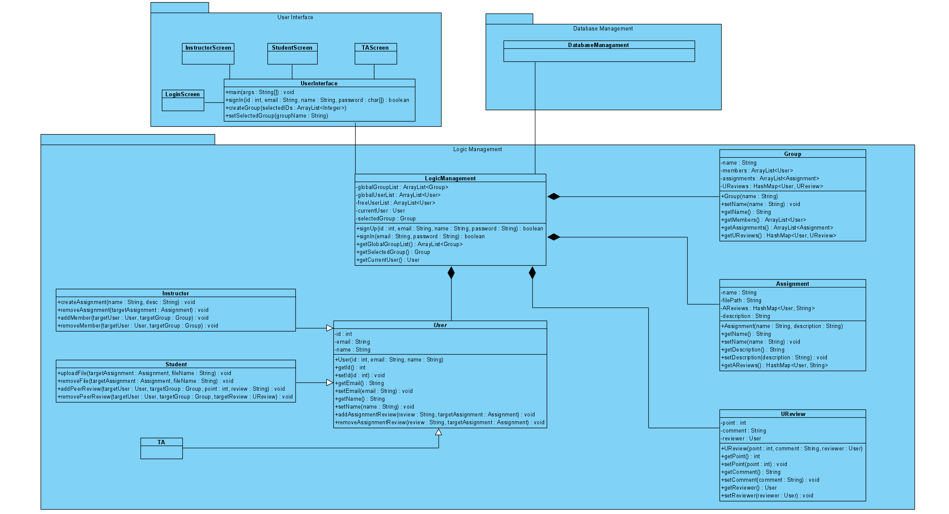

Slide 7
Login System Activity Diagram

Slide 8
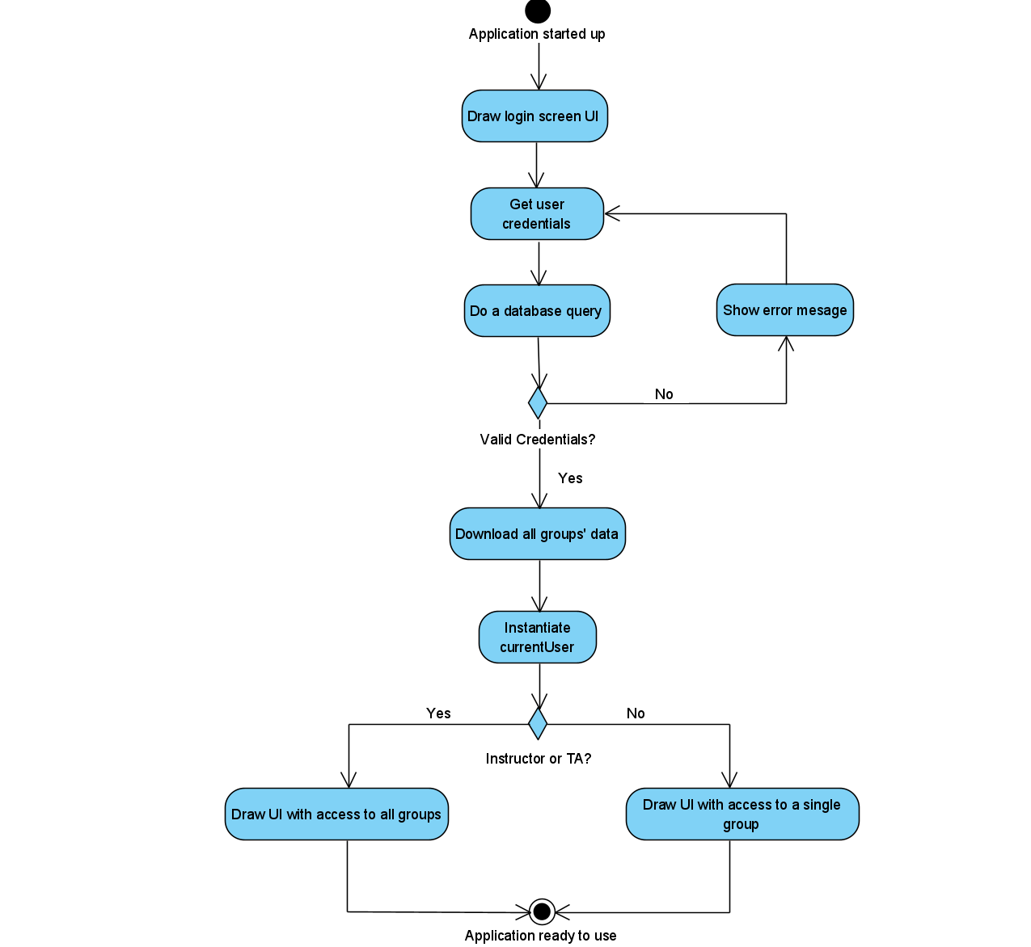

Slide 9
Instructor – Create Group Sequence Diagram

Slide 10
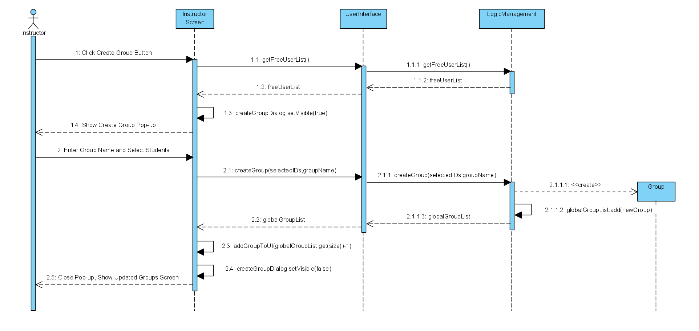

Slide 11
Instructor State Diagram

Slide 12
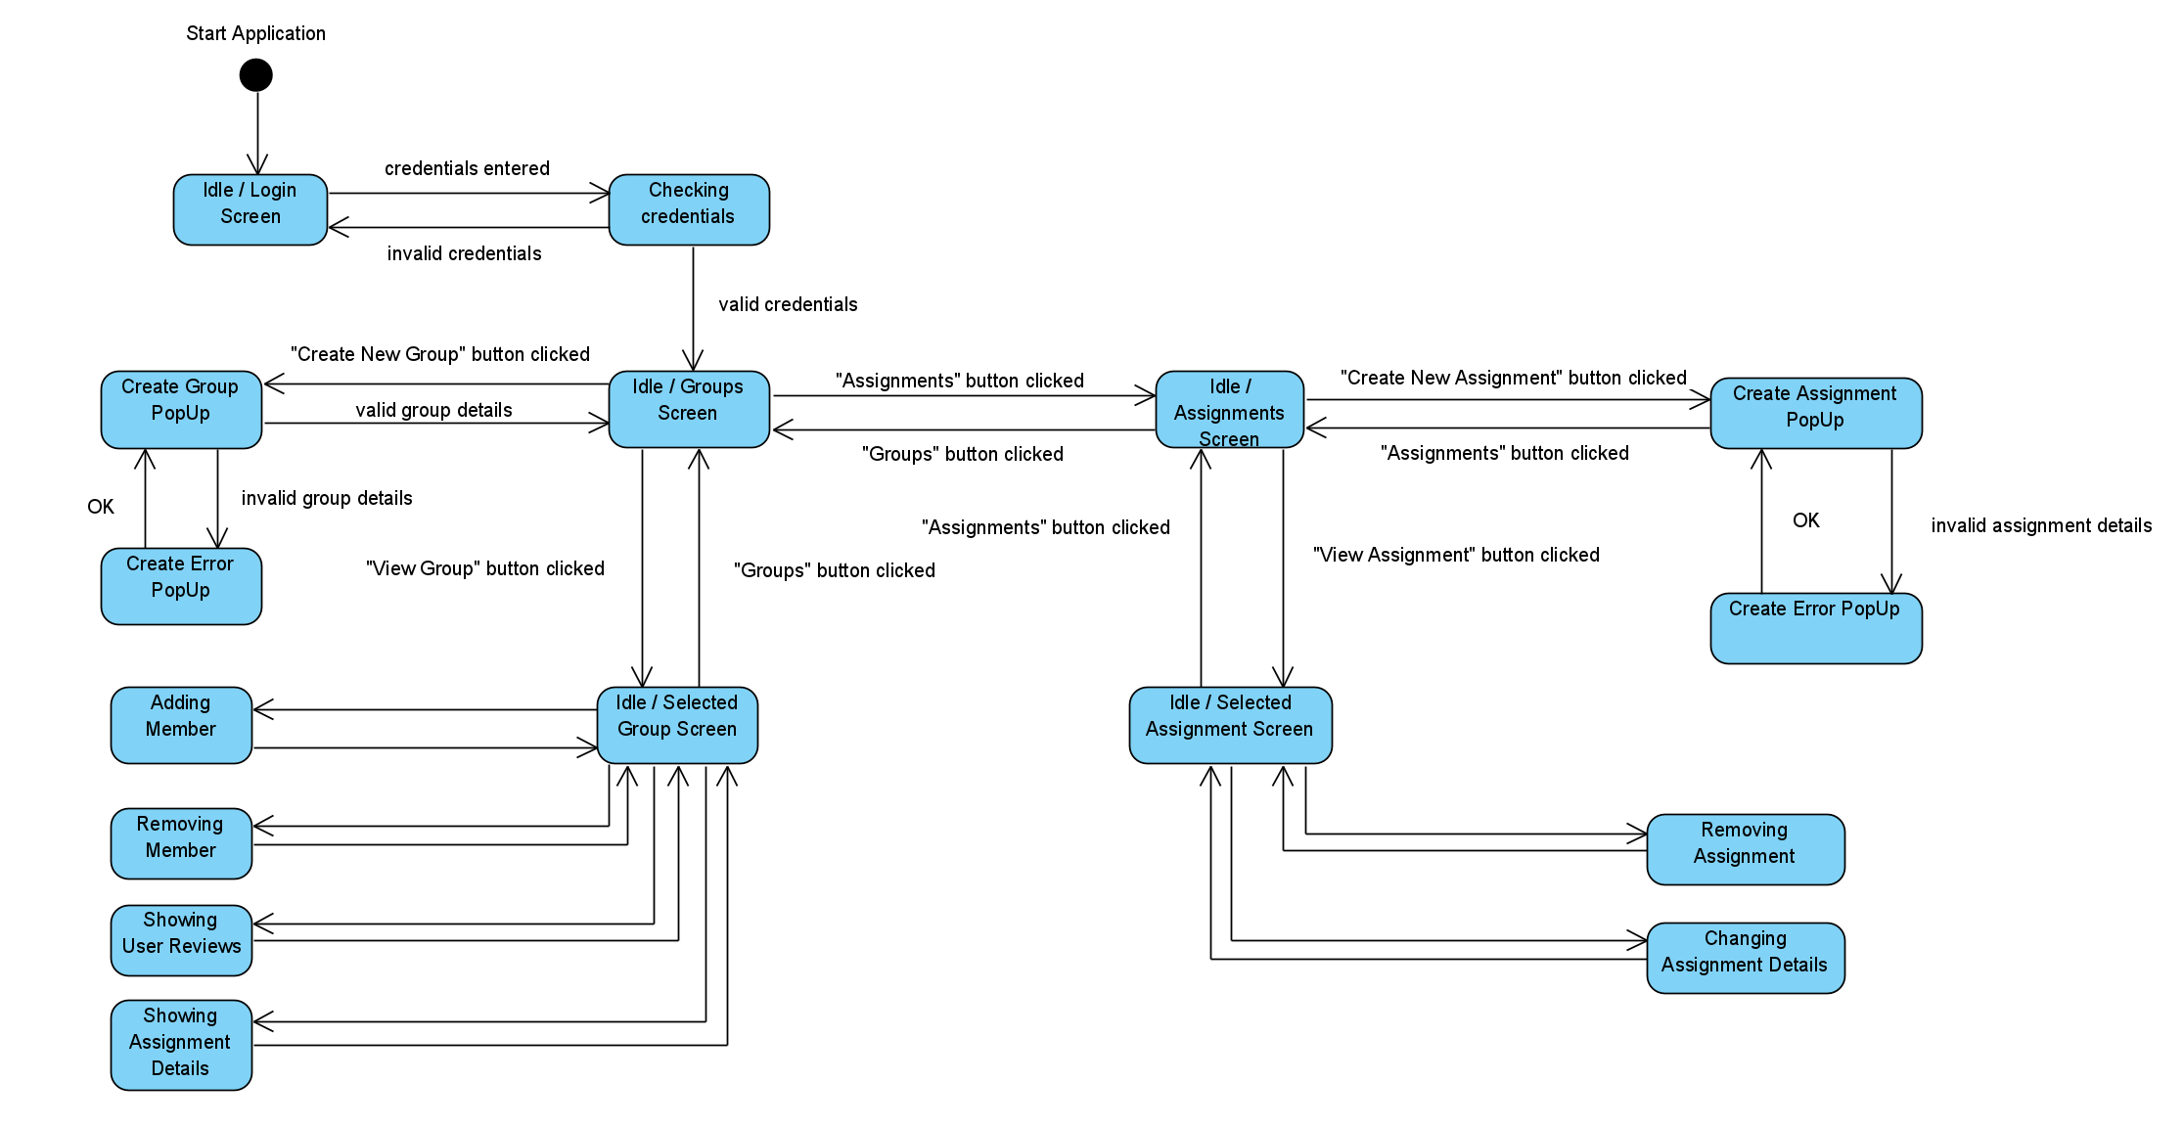

Slide 13
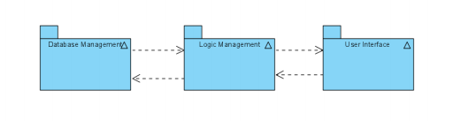
Design Report Summary
The program will use a 3-Layer Architectural Style.

Slide 14
The program will use Java.
The program will permanently store user credentials, group information, user and artifact review information.
The will be 3 types of accounts: Instructor, TA and Student.
The program will utilize event-driven control and follow a centralized design.

Slide 15
Boundary Conditions
Initialization: All data will be downloaded upon login.
Termination: All data will be deleted upon shutdown. Data will be periodically uploaded during runtime. The subsystems are not allowed to terminate individually.

Slide 16
Failure: 2 possible cases, database connection error and ungraceful exit from the program.
Database Error: The program will be able to detect invalid data, but not corrupted data. Corrupted data may lead to incorrect initialization or runtime exceptions.
Ungraceful Exit: The program will not have the opportunity to delete downloaded data, which may lead to security issues.

